Slide 1
DD Form 254 Overview
FISWG/NCMS Training Event
Dale Alberto / Shelby Atanacio
August 13, 2025

Slide 2

Agenda
Purpose
DD254 Instructions
Step-By-Step Explanation Guide
Resources
Definitions
Acronyms

Slide 3
Purpose
What is the purpose of the DD Form 254, DOD Contract Security Classification Specification?
Legally required by the Federal Acquisition Regulation (FAR) Subpart 4.4
Required to provide security classification guidance to US contractors and subcontractors requiring access to classified information.
Used by the Government Contracting Activity (GCA) to Specify classification requirements
Classification level & Safeguarding requirements
Access Requirements
Performance Requirements
Ensure proper security guidance is provided for the contract
Intended to eliminate misunderstanding
Prevent compromise or loss of classified information

Slide 4
General Principles
The DD Form 254 is your key to the accesses and allowances necessary to perform on the classified contract; It is imperative that you fully understand the form in its entirety and what it requires
Develop a process to review DD254s upon release and provide feedback / request updates to the GCA or Prime contractor
Flow-down requirements for subcontractors cannot exceed the requirements in the Prime DD Form 254
This includes the “flow down” of FCL, safeguarding, and accesses to a subcontractor.
Note: Some classified accesses require GCA approval prior to flowing down to a subcontractor

Slide 5
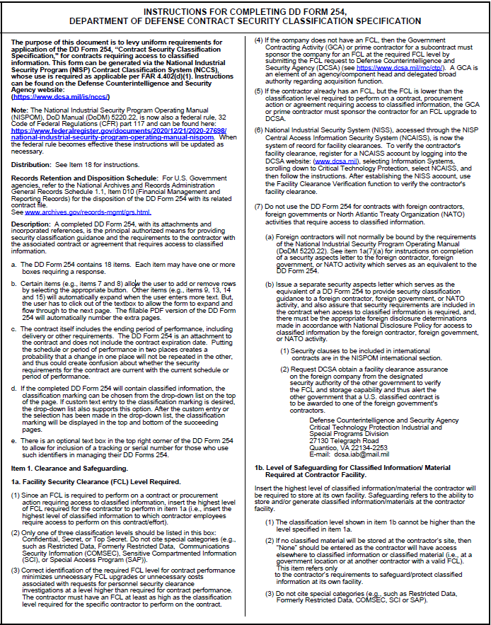
Instructions for Completing DD FORM 254
The purpose of the instruction is to levy uniform requirements for application of the DD Form 254, for contracts requiring access to classified information.
https://www.esd.whs.mil/Portals/54/Documents/DD/forms/dd/dd0254-Inst.pdf
Updated 7/11/2025

Slide 6
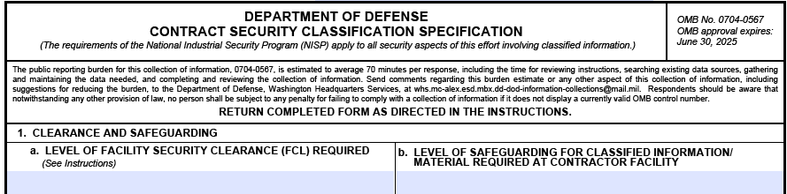
Explanation Guide – Block 1
1.a. Clearance level required for contract performance will determine the FCL (i.e. Secret, or Top Secret).
Note: NISS should be used to validate FCL / Safeguarding level. FCL process can be initiated with a DD254 from the GCA or Prime (with approval from the GCA).
1.b. Represents the level of classified storage at the performing facility or subcontractor facility (None, Secret, Top Secret)

Slide 7
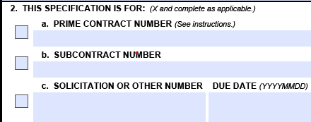
Explanation Guide – Block 2
2.a. Used by the Government with their Prime Contractor award. Note: Carry this number forward on subcontract DD 254s unless services required are not in direct support of a specific contract (ex. Guard Services, Janitorial) enter “Multiple Contracts” and check box 11.e (Perform Services Only)
2.b. Used by the Prime Contractor when flowing down to Subcontractor(s). Note: Typically, the Purchase Order (PO) number or contractual agreement number tied to the statement of work (SOW)
2.c. Used by both the government and contractor for solicitation purposes (Request for Information, Request for Proposal, etc.). This section cannot be used for actual award. Rather for award sections 2.a. or 2b. must be used.

Slide 8
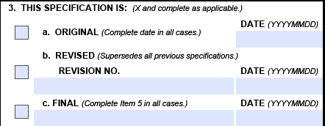
Explanation Guide – Block 3
3.a. Used for first version (prime, sub, or solicitation).
3.b. Used whenever an update is made to an original. Note: Keep the original date intact – this ensures historical reference.
3.c. Used to denote that classified retention has been authorized by the government beyond the NISPOM two-year allowance. A Final DD 254 dictates protection for the retained classified information.

Slide 9
Explanation Guide – Block 4
4. Used when the new contract is a follow-on to the previous contract. Checking this block “Yes” allows for the classified holdings to be transferred from the old contract to the new contract; thus, there is no need for disposition of the previous contract’s classified information. Enter the previous contract number in the provided block.
Note: the government must first provide allowance before a contractor can flow-down to a subcontractor.

Slide 10

Explanation Guide – Block 5
5. Used to denote that classified retention has been authorized by the government beyond the NISPOM two-year allowance.
A Final DD 254 dictates protection for the retained classified information. Note: Block 3.c will be checked as well.

Slide 11
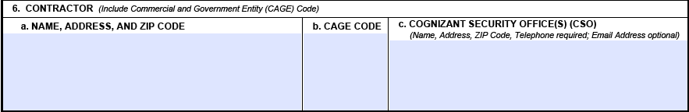
Explanation Guide – Block 6
6. Identifies the Prime Contractor to whom the GCA has awarded the contract or agreement that requires access to classified.
6.a. Enter the name and complete street address of the contractor
6.b. List the CAGE for the company listed in block 6.a.
6.c. Enter DCSA CSO with the full address and phone number

Slide 12
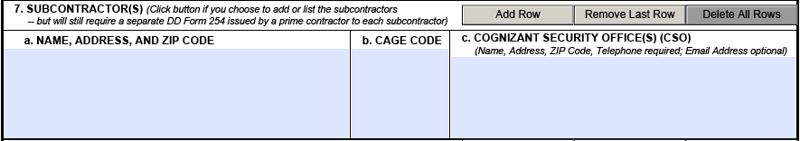
Explanation Guide – Block 7
7. Used by the contractor to list the subcontractor(s) that were awarded the contract, purchase order, etc.
7.a. List the name and complete street address of the subcontractor
7.b. List the CAGE for the subcontractor in block 7.a
7.c. Enter DCSA CSO with the full address and phone number

Slide 13
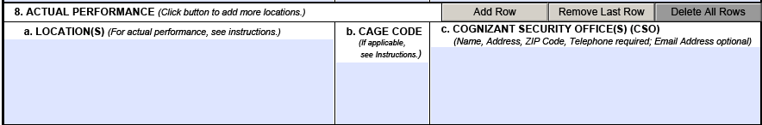
Explanation Guide – Block 8
8. Used to list the performance location(s) where classified access will occur. For multiple locations use the “add row” button and list all that apply. Note: If Block 1.b. Safeguarding shows “None,” then the contractor receiving the DD 254 cannot be listed as a performance location
8.a. This block lists the performance location. It can be used to list government, contractor, or another location where classified work will occur
8.b. List the CAGE for the contractor in block 8.a. Government locations will not have a CAGE.
8.c. Enter DCSA CSO with the full address and phone number

Slide 14
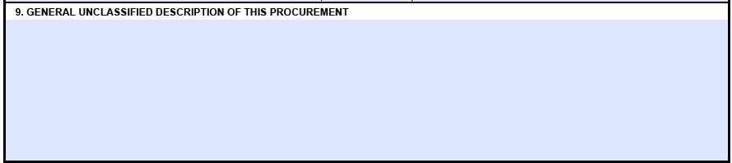
Explanation Guide – Block 9
9. Enter a short, concise and unclassified description of the procurement
Provide enough detail to paint an adequate picture of the project and do not use classified information such as project names or descriptive information.

Slide 15
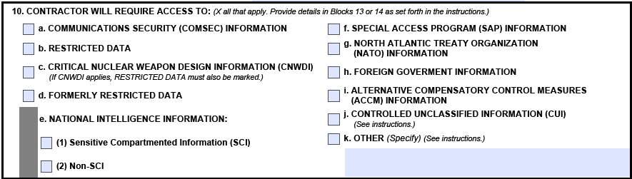
Explanation Guide – Block 10
10. This block is used to annotate access requirements for the contractor and their employees as determined by the GCA regardless of where the access will occur.
Provide details in blocks 13 or 14 as set forth in the instructions
Note: Flowing certain accesses down to a subcontractor will require GCA approval and signature on the flowdown DD254.

Slide 16
Explanation Guide – Block 10.a
10.a. COMSEC. This access should be checked if the contractor will have access to any NSA COMSEC equipment/information regardless of classification.
IMPORTANT: COMSEC access for subcontractors requires GCA approval, and access to classified COMSEC requires a final US Government clearance at the appropriate level. Special Briefing Required

Slide 17
Explanation Guide – Block 10.b
10.b. Restricted Data. This access should be checked if the contractor requires access to RD information in performance of the contract.

Slide 18
Explanation Guide – Block 10.c
10.c CNWDI. This access should be checked if the contractor requires access to DoD CNWDI in performance of the contract.
Note: If this block is checked then 10.b RD must also be checked.
IMPORTANT: CNWDI access for subcontractors requires GCA approval and access to CNWDI requires a final US Government clearance at the appropriate level. Special briefing required

Slide 19
Explanation Guide – Block 10.d
10.d. FRD. This access should be checked if the contractor requires access to FRD information in performance of the contract.

Slide 20
Explanation Guide – Block 10.e
10.e (1) SCI. This access should be checked if the contractor requires access to SCI in performance of the contract. The Director of National Intelligence (DNI) has jurisdiction and control over National Intelligence Information.
The GCA is responsible for ensuring applicable DNI and DCI Directives are incorporated in the guidance provided to contractors.
DCSA does not conduct security reviews for SCI
IMPORTANT: SCI access for subcontractors requires GCA approval

Slide 21
Explanation Guide – Block 10.e
10.e (2) Non-SCI. This block should be checked if the contractor requires access to Non-SCI in performance of the contract.
Non-SCI is collateral intelligence information (e.g. NOFORN information).
IMPORTANT: Non-SCI access for subcontractors requires GCA approval

Slide 22
Explanation Guide – Block 10.f
10.f. SAP. This block should be checked if the contractor requires access to Special Access Program information in performance of the contract.
Applicable GCA’s SAP office is responsible for providing the contractor with the additional security requirements
IMPORTANT: SAP access for subcontractors requires GCA approval

Slide 23
Explanation Guide – Block 10.g
10.g. NATO. This block should be checked if the contractor requires access to NATO information in performance of the contract.
IMPORTANT: NATO access for subcontractors requires GCA approval and access to NATO information requires a final US Government clearance at the appropriate level. Briefing/Debriefing requirement

Slide 24
Explanation Guide – Block 10.h
10.h. FGI. This block should be checked if the contractor requires access to FGI in performance of the contract. FGI includes both US information with FGI embedded as well as another country’s classified information.
Note: Access to FGI requires a final US Government Clearance at the appropriate level and GCA approval is required prior to subcontracting.

Slide 25
Explanation Guide – Block 10.i
10.i. ACCM. This block should be checked if the contractor requires access to ACCM information in performance of the contract.
GCA will provide appropriate classification guidance separate from the DD 254.
ACCM are security measures used by the government to safeguard classified intelligence or operations when normal measures are insufficient to achieve strict need-to-know controls but where SAP controls are not required.

Slide 26
Explanation Guide – Block 10.j
10.j. CUI. Should be selected if the contract requires access to CUI in accordance with GCA specific classification guidance.
Note: block 11.l. (CUI storage) will need to be checked as well.

Slide 27
Explanation Guide – Block 10.k
10.k. Other. This block is used for any additional access requirements required in performance of the contract such as handling caveats or dissemination controls not listed (e.g. additional security requirements outlined in applicable DNI directives).

Slide 28
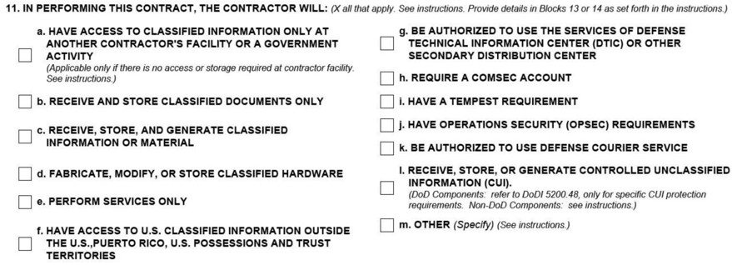
Explanation Guide – Block 11
11. This block is used to provide requirements needed for performance of the contract. The GCA or prime contractor for a subcontract must comply with the instructions where it states that certain items must not be check together.

Slide 29
Explanation Guide – Block 11.a
11.a. Select if block 1.b. Safeguarding is marked as “None” since there is no classified performance at the subcontractor’s location and be sure the subcontractor facility is not listed in block 8
Note: If 11.a is checked do not check 11b, 11c, 11d, 11h, 11i, 11k

Slide 30
Explanation Guide – Block 11.b
11.b. Select this section if block 1.b. Safeguarding is marked with a classification, the subcontractor will access classified at their location (the subcontractor is listed in block 8), but the subcontractor will not generate new classified material.
Note: If block 11.b is checked do not select 11.a,11.c,11.d,11.h, 11.i, 11.k

Slide 31
Explanation Guide – Block 11.c
11.c. Select if block 1.b. Safeguarding is marked with a classification and the subcontractor will both access and generate classified at their location (the subcontractor is listed in block 8).
Note: Neither 11.a. or 11.b. will be checked.

Slide 32
Explanation Guide – Block 11.d
11.d. select this block if the subcontractor is expected to fabricate or use hardware containing classified material at the subcontractors own cleared facility.
If 11.d is checked, then block 1.b would be completed at the appropriate classification level of safeguarding required. If 11.d is checked, then items 11.a and 11.b are not checked.

Slide 33
Explanation Guide – Block 11.e
11.e. Select for contracts such as guard service, graphic art services, maintenance services, janitorial, etc. In all cases, block 1.b. will show “None” and block 11.a. will be checked. Actual knowledge of classified is not required in these cases, but reasonable security measures cannot be employed to prevent aural or visual access to classified.
Note: If block 11.e is checked and Prime Contractors are Subcontracting services that do not apply to a specific contract, block 2.a can be termed “Multiple Contracts” instead of the entering a prime contract number and an explanation can be provided in block 13.

Slide 34
Explanation Guide – Block 11.f
11.f. Select this section if access to classified information is required overseas in a foreign country. Examples include access at a U.S. military installation, or a U.S. Embassy located in a foreign country.
Note: If 11.f is checked, block 13 must indicate the US activity, city and country where the performance will occur outside of the US, PR, US Possessions and Trust Territories.

Slide 35
Explanation Guide – Block 11.g
11.g. Select this section if the subcontractor is required to have access to classified information stored within DTIC databases or another distribution center as noted by the government.
Note: The GCA submits DD Form 1540 on behalf of the contractor and for Subcontractors the prime submits the DD Form 1540 with GCA verifying need to know.

Slide 36
Explanation Guide – Block 11.h
11.h. If block 10.a. COMSEC is checked and the subcontractor is required to store accountable COMSEC material at its location, then this block will also be checked.
Note: This material must be controlled within the COMSEC Material Control System (CMSC) or an in-process accounting system.

Slide 37
Explanation Guide – Block 11.i
11.i. Check TEMPEST if the GCA specifically requires the subcontractor by contract in the US to apply TEMPEST requirements.
Note: Prime Contractors cannot impose TEMPEST requirements on subcontractors without GCA approval.
If this item is checked, then block 14 must also be marked “yes” and contract clauses and additional clarifying information must be added to block 13.

Slide 38
Explanation Guide – Block 11.j
11.j. Select this section if the government has imposed real OPSEC requirements onto the contractor. Typically the government will provide an OPSEC plan or require one as a contract deliverable that must be executed once approved.
Note: If this item is checked then block 14 must be marked “yes” and additional requirements must be added in an attachment. Pertinent contract clauses should be identified and clarifying information should also be provided in block 13.
Contractors may not impose OPSEC requirements on subcontractors unless the GCA approves the OPSEC requirements.

Slide 39
Explanation Guide – Block 11.k
11.k. Select this block if the Defense Courier Service is necessary to transport classified items to or from the subcontractor facility. Only certain classified material qualifies for movement by USTRANSCOM’s Defense Couriers and the GCA must have approval to impose the requirement.
Note: GCA approval is required before a prime contractor can authorize a subcontractor to use the services of USTRANSCOM’s Defense Couriers.

Slide 40
Explanation Guide – Block 11.l
11.l. Check this block if 10.j. is checked and one of the other blocks (11.a, 11.b, 11.c, or 11.d) is checked that indicates that this contract requires access to classified information for performance.
Note: The NISPOM does not provide guidance concerning CUI so the GCA must provide guidance on the protection procedures in block 13.

Slide 41
Explanation Guide – Block 11.m
11.m. This block is used to add any additional performance requirements not covered in blocks 10 or 11. A typical example is a reference to a government classified information system such as SIPR or JWICS.
Note: When this block is checked block 13 should provide clarifying information.

Slide 42
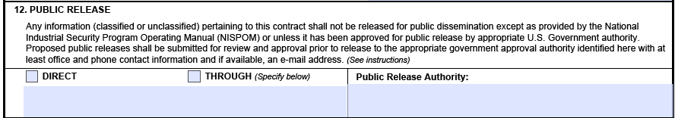
Explanation Guide – Block 12
12. This block is used to instruct the contractor on how to request public release authorization if allowed. The GCA office that has public release authority will provide guidance and the procedures for such a request from the contractor to the GCA.
Note: All subcontractor requests must flow through the prime contractor to the GCA. The contractor issuing the DD 254 will list their location with the “Through” block selected.

Slide 43
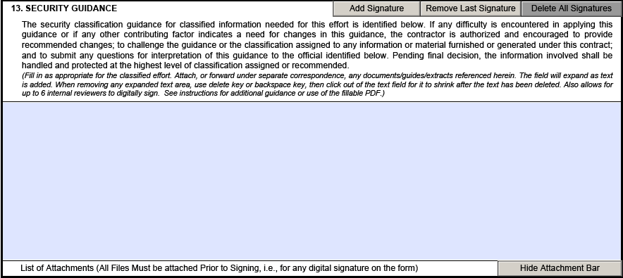
Explanation Guide – Block 13
13. This block refers to any security guidance that is required for performance of the contract. It is a place to explain anything that might be unclear, confusing or important. This is also where security classification guidance is listed, applicable government manuals are provided and gives reasons for classification.
Note: Block 13 is used to elaborate on items checked in block 10 & 11

Slide 44
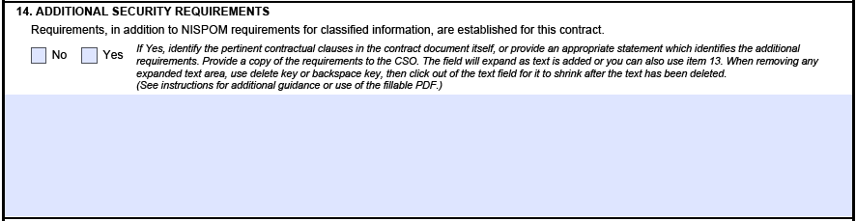
Explanation Guide – Block 14
14. This block is used to provide additional security requirements that are not already listed in the NISPOM. Typically, references to 10.e.(1) SCI, 10.f. SAP, 10.i. ACCM, 10.j. CUI, 11.i. TEMPEST, 11.j. OPSEC, and 11.l CUI storage will require additional instructions and will require this block to be checked “Yes.”
Note: Use of this block denotes requirements above and beyond NISPOM and likely requires additional resources to execute. Costs incurred due to additional security requirements are subject to negatiations between the contractor and GCA
Prior approval from the GCA is required before a prime contractor can impose additional security requirements on a subcontractor.

Slide 45
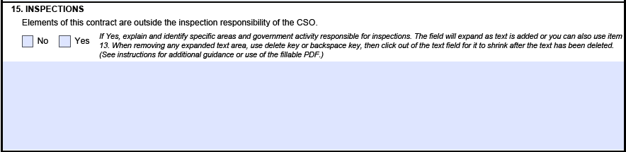
Explanation Guide – Block 15
15. If inspections will be conducted by an organization other than DCSA complete block 15. Example of agency assuming responsibility is when access to SCI is required in item 10e. Enter appropriate Agency/Military SIO that has exclusive security responsibility for SCI material released or developed under the contract.
Note: Inspections by an agency other than DCSA does not change the CSO designation for the oversight of the baseline FCL and does not relieve the contract activity from providing a copy of the DD 254 to DCSA.

Slide 46
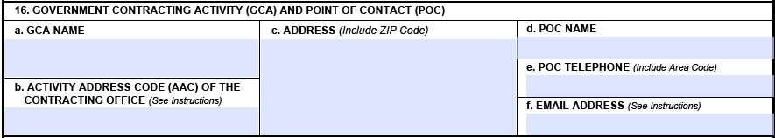
Explanation Guide – Block 16
16. This block is used to annotate the GCA’s point of contact information. The government will provide the information on the prime contractor DD 254. All subcontract DD 254s with exception to “multiple contracts” services only efforts, should include GCA information even though all requests to the government must be routed through the prime contractor.

Slide 47
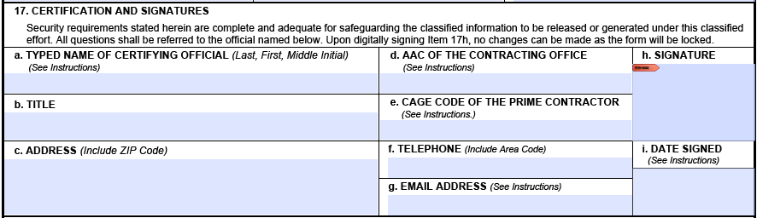
Explanation Guide – Block 17
17. This block is used by the approver of the DD 254, whether government or a contractor. It is typically recommended that either contracting or security sign this section of the DD 254. If you require additional signature approvals/concurrences, they may be added using the “Add Signature” tab in block 13.

Slide 48
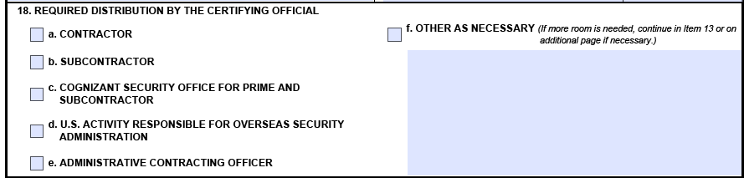
Explanation Guide – Block 18
18. This block is used to annotate the office that should receive a copy of the DD Form 254. It should be completed as required by the certifying official who signed in block 17.
Note: As a minimum the DD254 will be provide to DCSA, Contractor FSO, Subcontractor FSO (as applicable) the GCA POCs, and all offices checked for distribution.

Slide 49
Resources
Instructions for Completing DD FORM 254
NCCS SAAR Process Job Aid
Preparing the DD FORM 254
Common Contract Clauses for DD Form 254
DD FORM 254
DD FORM 254 Glossary

Slide 50
Definitions
Classified Contract – A contract that requires access to classified information for performance purposes
Collateral – Classified information not requiring additional security protections
Confidential – Classification level for information that if compromised would cause damage to National Security
Contracting Officer – Individual responsible for issuing a contract and contract maintenance
COR – Representative of the Contracting Officer responsible for contract maintenance
DD Form 254 – Contract Security Classification Specification providing classified access and safeguarding needed for contract performance. Included in Section J of the contract
Facility Clearance – Level of Clearance required by the company performing the work
Follow-on contract – A contract that succeeds a previous contract with the same or very similar work performance and on-site classified access and storage requirements

Slide 51
Definitions
Non-SCI – Designation for intelligence information that is at the collateral level. Typical identifiers are NOFORN, ORCON, PROPIN, WININTEL, etc.
Prime Contractor – The contractor company awarded the contract directly from the government
Safeguarding – Level of classified material to be stored at the contractor facility
Secret – Classification level for information that if compromised would cause serious damage to National Security
Subcontractor – The contractor company performing on a contract provided by the prime contractor. Subcontractor does not perform work directly for the government
Top Secret – Classification level for information that if compromised would cause exceptionally grave damage to National Security

Slide 52
Acronyms
AAC – Activity Address Code
ACCM – Alternative Compensatory Control Measures
CAGE – Commercial and Government Entity
CNWDI – Critical Nuclear Weapon Design Information
COR – Contracting Officer Representative
CSA – Cognizant Security Agency
CSO – Cognizant Security Office
CUI – Controlled Unclassified Information
COMSEC – Communication Security
DCSA – Defense Counterintelligence & Security Agency
DIA – Defense Intelligence Agency
DOE – Department of Energy
DoD – Department of Defense
FAR – Federal Acquisition Regulation
FCL – Facility Clearance

Slide 53
Acronyms
FGI – Foreign Government Information
FRD – Formerly Restricted Data
GCA – Government Contracting Activity
MFO – Multiple Facility Organization
NATO – North Atlantic Treaty Organization
NISP – National Industrial Security Program
NISPOM – National Industrial Security Program Operating Manual
NSA – National Security Agency
ODNI – Office of the Director of National Intelligence
RD – Restricted Data
SAP – Special Access Program
SAPF – Special Access Program Facility
SCI – Sensitive Compartmented Information
SCIF – Sensitive Compartmented Information Facility
TEMPEST - Telecommunications Electronics Material Protected from Emanating Spurious Transmissions

